Slide 1

Energiewendezone Ltd
Eine Fallstudie
Amy Perry, Leiterin Projektentwicklung (Wasserstoff)
Notes:
Thank you for inviting me to speak today, I am really pleased to take part in your conference and have the opportunity to tell you about Energy Transition Zone and what we are doing in Scotland.

Slide 2
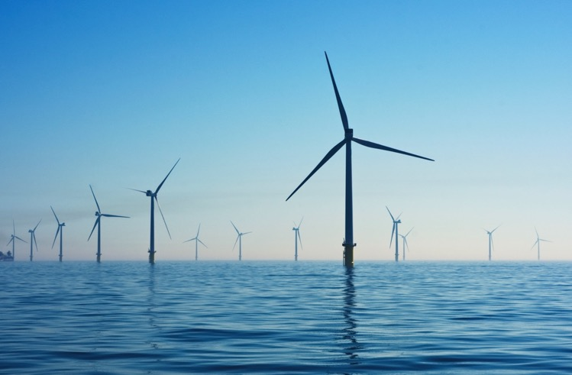
REGIONAL FOKUSSIERT, GLOBAL IN DER PERSPEKTIVE
ETZ Ltd wird den Nordosten Schottlands als weltweit anerkanntes integriertes Energiecluster neu positionieren, das sich auf die Erreichung von Netto-Null konzentriert, und eine langfristige internationale Industriebasis aufbauen, die nachhaltige Arbeitsplätze und Wachstum in Schottland und Großbritannien schafft.
Notes:
ETZ Ltd is a not-for profit company enabled by significant funding from the private sector, Opportunity North East (£5.7m) and both the Scottish (£26million) and UK Governments (£27million).
Our vision is to reposition the North East Scotland region from the oil and gas capital of Europe to the Net Zero Energy Capital of Europe.
We have key targets to create 2,500 direct jobs and a further 10,000 energy transition-related jobs across the region.
The delivery of a successful energy transition will take investment in strategic infrastructure, technology and innovation, supply chain development and skills – and that’s exactly what ETZ Ltd has been set up to do.
We have two main focuses of activity – firstly to be the catalyst to create an energy cluster and I will take you through some of the initiatives we are undertaking.
And secondly to deliver a focal point for the energy cluster in the form of a revitalised development zone – and I will tell you more about that later.

Slide 3
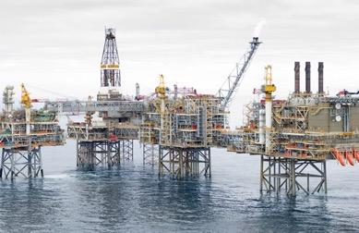
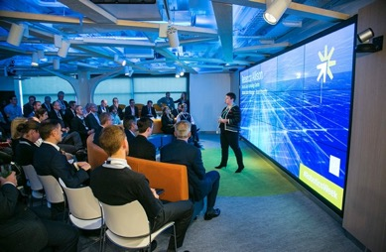
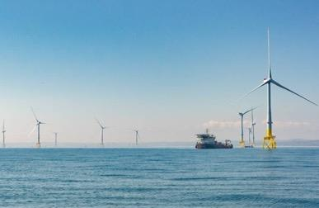
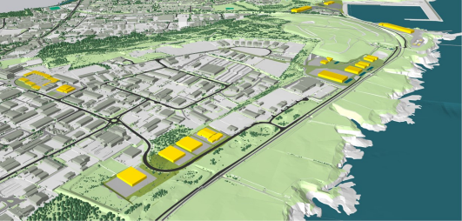


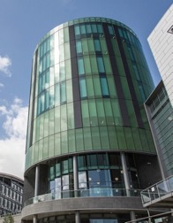
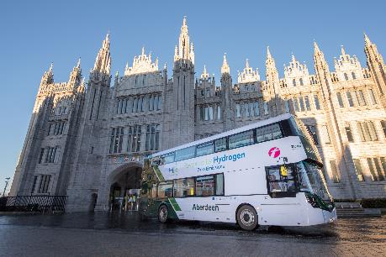
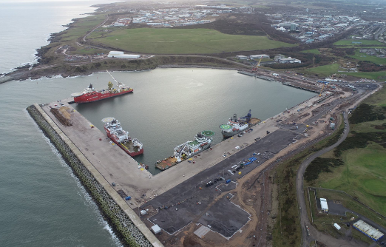
Ein Überblick über die Stärken von Nordostschottland
Öl & Gas
Infrastruktur
und Expertise
Netto-Null
Technologiezentrum
Integrierte Energieversorgungskette
Energiewendezone
Unterwasseringenieurwesen und -technik
Industrieorientierte Universitäten und FE-Hochschulen
Laufende Projekte der Energiewende
Hafeninfrastruktur und -tauglichkeit
Eine Region mit den richtigen Referenzen und einer starken Erfolgsbilanz bei der Umsetzung einer kohlenstoffarmen Energiezukunft.
Notes:
And I want to start by setting the scene and describing the North East of Scotland’s strengths –
Legacy of O&G infrastructure and expertise – the North East Scotland region has been built around the Oil and Gas sector for the past 50 years. We have the largest proportion of energy supply chain companies in the UK and we know that 80% of skills can be transferred to net zero technologies.
Net Zero Technology Centre - a not-for-profit organisation working with industry, government and academia driving technology innovation to accelerate the energy transition to net zero – currently working on a hydrogen backbone link study looking at how Scotland can export hydrogen to Europe.
Industry focused universities and college – University of Aberdeen was founded in 1495 and it has a long history of industry led R&D
Ongoing energy transition projects – 10 years experience in hydrogen production and vehicle deployments
Port & Infrastructure capability - £420m harbour development making it one of the biggest non-tidal deep water port developments in the UK

Slide 4
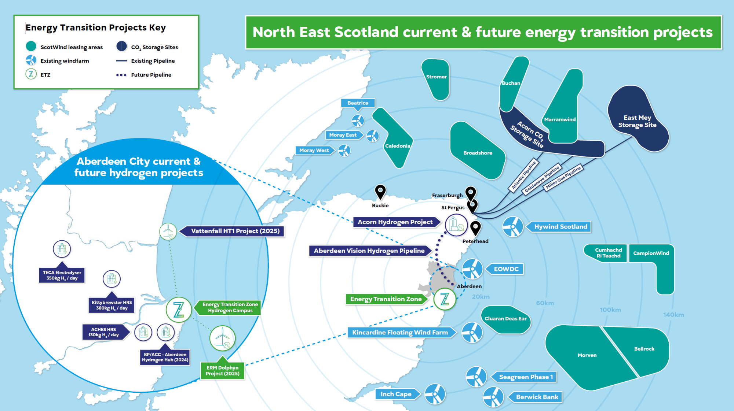
Notes:
The opportunity in this region is huge –
As a result of the seabed leasing rounds for offshore wind (ScotWind and INTOG) a massive 17GW of agreed floating wind projects are within 100 nautical miles of Aberdeen accounting for 73% of all such projects in Scottish waters – so the opportunity is significant.
We also have world class CO2 storage potential utilising dormant O&G infrastructure and undersea storage sites 2.5km below the North Sea bed.
(Acorn CCUS project – based up the coast at St Fergus – received Track 2 funding to take this forward – plans to capture and store ghg emissions and store in depleted gas reservoirs under the North Sea
Aberdeen Vision Hydrogen Pipeline – looking at commercial viability of injecting hydrogen into gas network - dedicated pipeline from St Fergus to Aberdeen and beyond – SMR production of H2 from St Fergus)

Slide 5
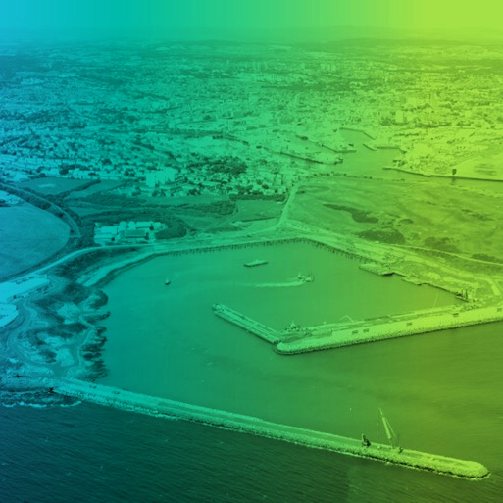
ETZ Focus areas
Regional catalyst and Energy Transition Zone
Erhöhung der Investition in Höhe von 400 Millionen Pfund im Aberdeen South Harbour (ASH)
Bereitstellung eines Campus-Modells in der Energiewendezone
Weg zum Netto-Null-Betrieb bis 2030 und Verankerung von Netto-Null
Ermöglichung von hochwertigen Fertigungen von Offshore-Wind und Wasserstoff
Bereitstellung von Grünflächen und Gemeinschaftseinrichtungen
Anreize schaffen für Investitionen aus dem Ausland für hochwertige Produktion
Unterstützung der Infrastruktur für das aufstrebende Geschäft der Wasserstoffproduktion, -speicherung und – verteilung
Gerechter Weg zur Lieferkettentransition & Finanzierung für die Herausforderungen der Energiewende
Internationalisierung der Offshore-Technik, der Herstellung von Produkten
INNOVATION, R&D
& TECHNOLOGIE
KOMPETENZEN &
QUALIFIKATIONEN
LAND & INFRASTRUKTUR
HOCHWERTIGE HERSTELLUNG
& SUPPLY CHAIN
COMMUNITY
LOCATION
Sitz des National Floating Wind Innovation Centre (FLOWIC)
Standort der vorgeschlagenen Test- und Demonstrationsanlagen für grünen Wasserstoff (GHTDF)
Energy Incubator & Scale-up Hub zur Unterstützung von grünen Start-ups und Scale-ups (EISH)
Zusammenarbeit mit der lokalen Gemeinschaft, um integrative Beschäftigungsmöglichkeiten zu schaffen
Durchführung des National Energy Skills Accelerator (NESA) und des Pilotprogramms für einen gerechten Übergang
Schottlands erstes Advanced Manufacturing Skills Hub (AMSH) – Finanzierung eines gerechten Übergangs
Notes:
ETZ was established in 2021 to take forward a range of initiatives and programmes designed to make individuals and organisations accelerate their own energy transition ambitions.
We have 4 focus areas:
Capability & Skills
Innovation, R&D and Technology
Land & Infrastructure
High Value Manufacturing and supply chain
To date we have engaged with well over 500 companies across our supply chain initiatives so they can further their own energy transition ambitions.

Slide 6
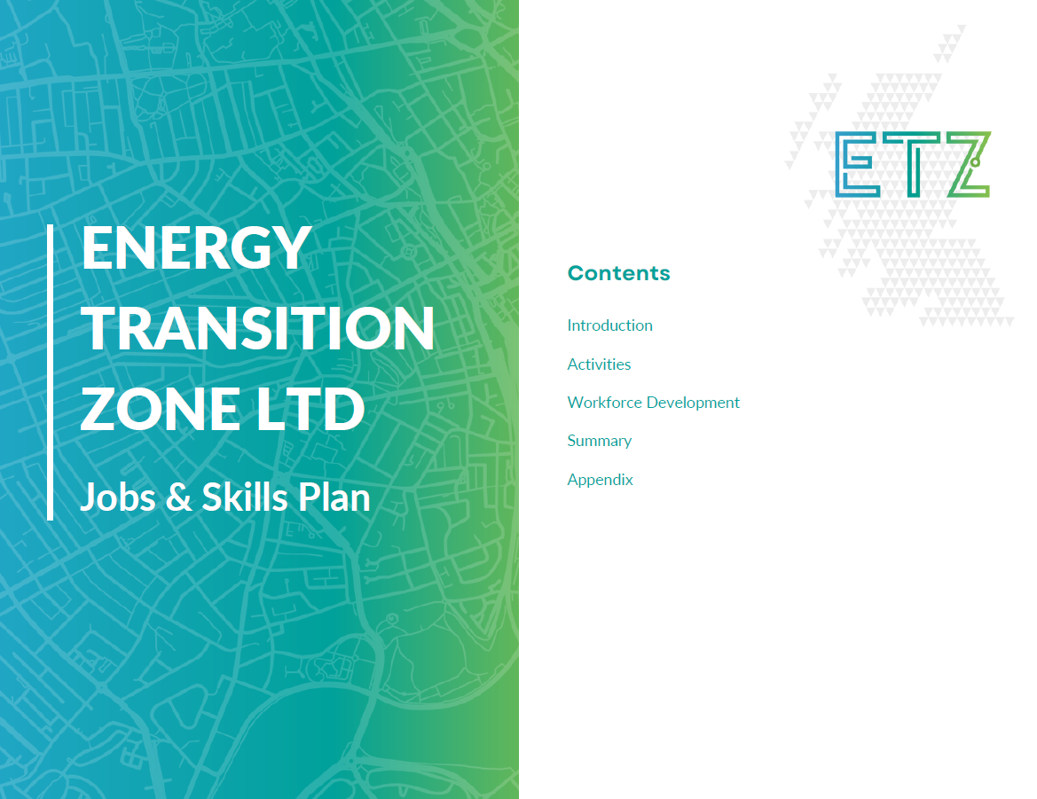
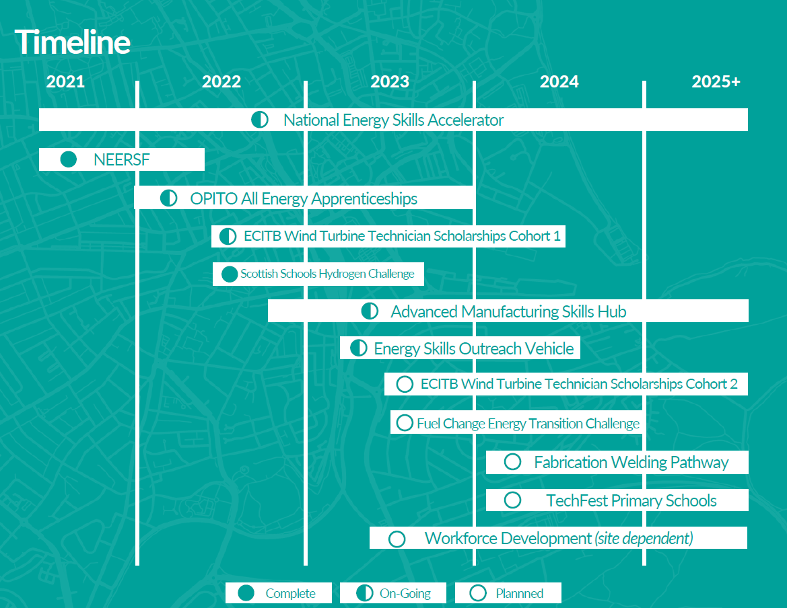
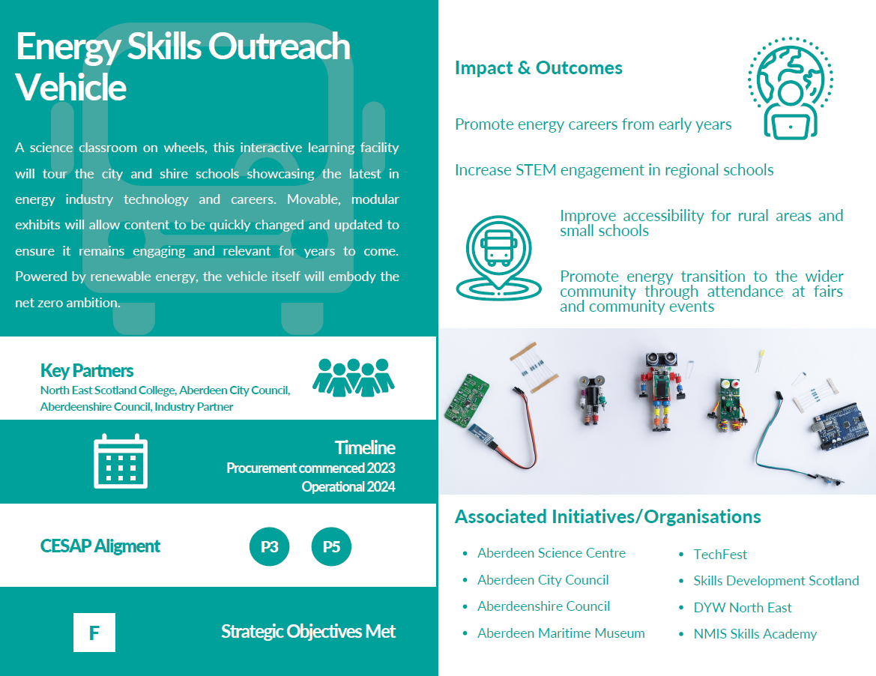
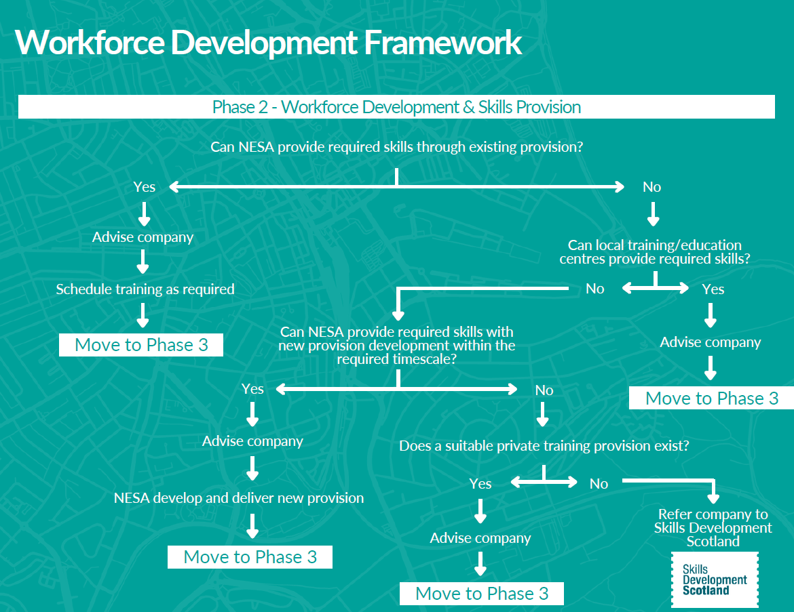
Capability & Skills
Der Jobs & Skills Plan wurde im April 2023 veröffentlicht, um das Bewusstsein für unsere Initiativen zu stärken und sie zu kommunizieren , die Zusammenarbeit zwischen den Organisationen zu fördern und einen Rahmen für die Personalentwicklung mit der ETZ festzulegen.
Notes:
ETZ recognises that supporting industry to access the skilled workforce they need to maximise energy transition opportunities is key and one of our main focuses.
In April 2023 we published a jobs and skills plan to communicate and raise awareness around our initiatives, promote collaboration between organisations, and set out a framework for workforce development with the ETZ.
We want to be able to up-skill the current workforce as well as encouraging new students to join the industry.

Slide 7
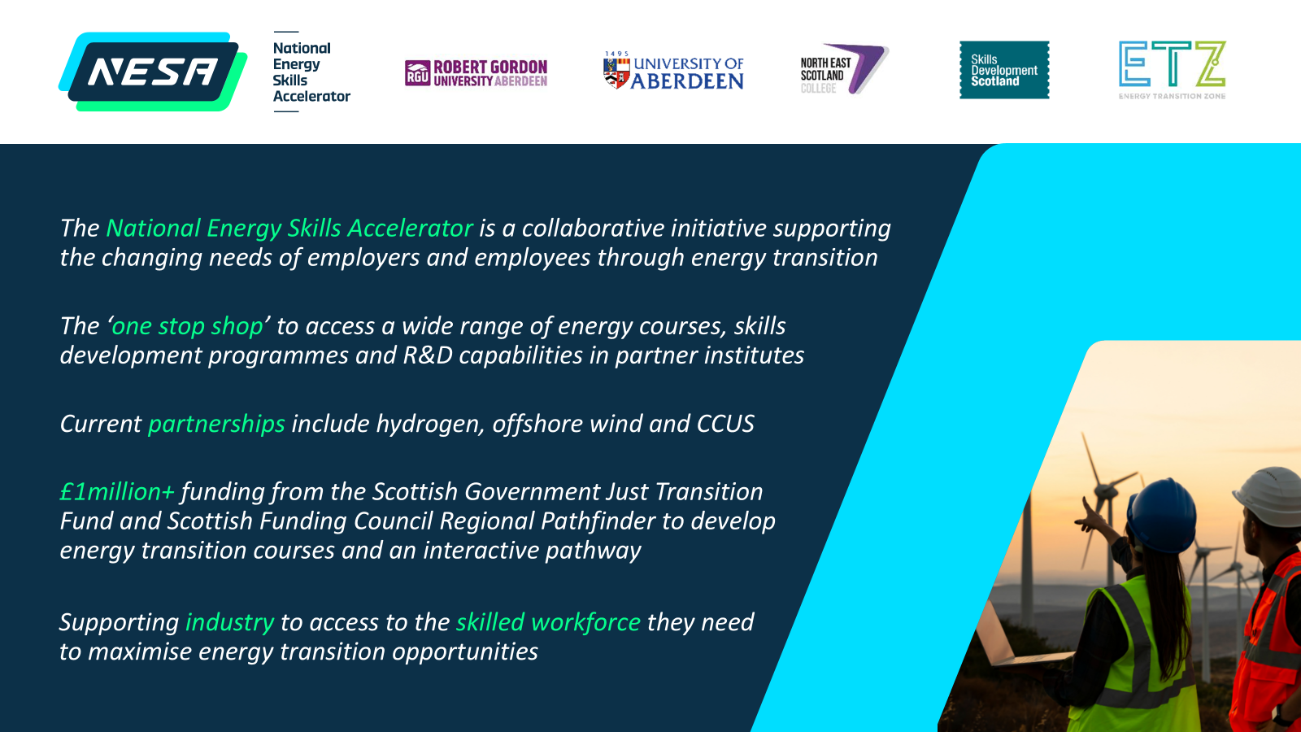
Notes:
And the National Energy Skills Accelerator was established which is a collaborative initiative supporting the changing needs of employers and employees through energy transition
This initiative brought together the 2 local universities and further education college as well as Skills Development Scotland (national skills body for Scotland).
This ‘one stop shop’ provides users with access to a wide range of energy courses, skills development programmes and R&D capabilities in partner institutes.
This collaboration delivers 37 energy transisition related courses including 15 newly developed programmes across 3 North East Scotland higher and further education providers.

Slide 8
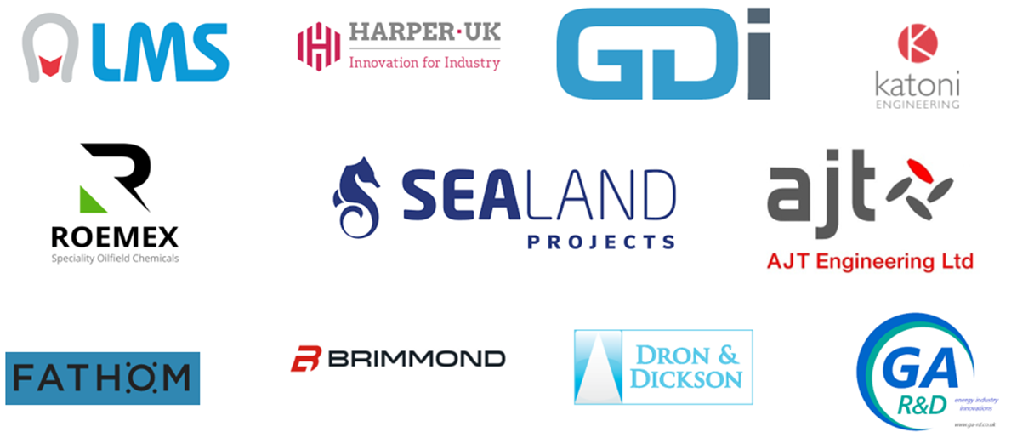
Unterstützung der Lieferkette
Über 500 Unternehmen über neue Energiemöglichkeiten informiert
250 Unternehmen werden bei der Erschließung internationaler Märkte gecoacht
30 Unternehmen entwickelten digitale Strategien, um die Geschäftsfähigkeiten zu verbessern
50 Personen beschleunigten ihre Geschäftsstrategien für die Energiewende
Unterstützung von 60 Unternehmen durch fit4 Offshore Renewables
Unternehmen, die durch Pilotempfänger des Just Transition Fund unterstützt werden.
Notes:
ETZ also recognises the importance of preparing the regional supply chain for the new opportunities that Energy Transition presents, and we offer a number of support programmes to help businesses identify new markets and ready themselves for these new opportunities.
These include pathway programmes such as:
Fit 4 Offshore Renewables programme – which supports supply chain companies with their entry and growth in the industry by assisting them on a 12 month programme that builds the tools and knowledge to succeed in the industry
Green Energy Masterclasses, which are gaining in popularity. We hold one on hydrogen each year, this year with over 180 participants.
Strategy Shift workshops,
Accelerating Digital Adoption programmes
International Knowledge Exchanges – on key energy transition topics such as geothermal, water
Over 500 companies educated about new energy opportunities
250 companies coached to branch into international markets
30 companies developed digital strategies to enhance business capabilities
50 individuals accelerated their business strategies for energy transition
Supported 60 companies through fit4 Offshore Renewables

Slide 9

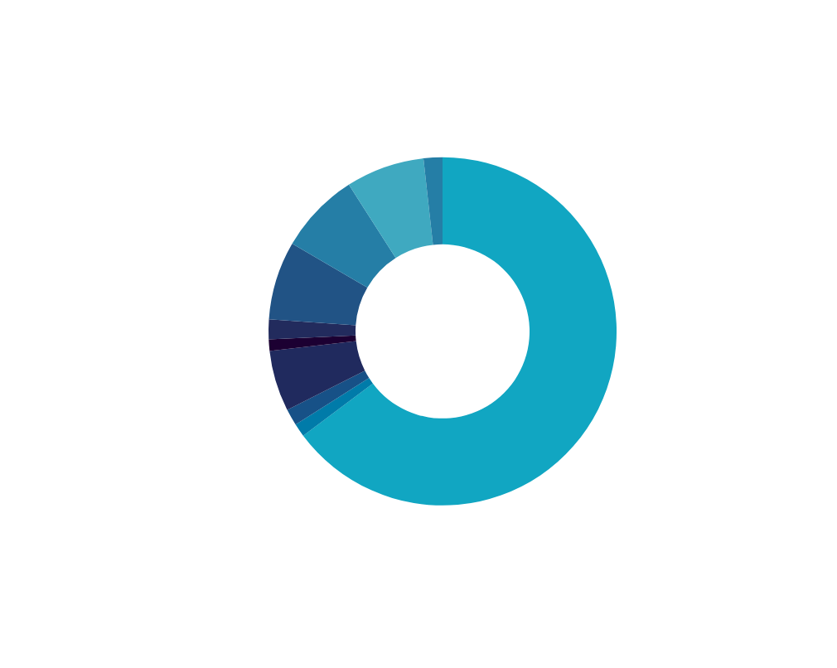




ETZ Ltd Supply Chain Challenge Fonds
Projektlaufzeit 2 Jahre: Geschäftsjahre 22/23 und 23/24
ETZ Beteiligung
Investitionen des privaten Sektors
£3.4M
£5.8M
Unterstützte Standorte
Grid Capacity
£250K
Battery Storage
£60K
ETZ Ltd Funding by Sector
Hydrogen
£63k
24
26
Oil and Gas
£36k
Offshore Wind
£2.2M
Geothermal
£53K
Tidal
£42K
Unternehmen
Projekte
Notes:
We also operate an Energy Transition Challenge Fund which offers grants of up to £250k for Infrastructure Upgrades and Capital Equipment - 50% match funded by the company.
To date ETZ has invested £3.4million with private sector investment of £5.8m, helping 24 high-growth potential companies across North East Scotland's energy sector to enter the low-carbon industry.

Slide 10
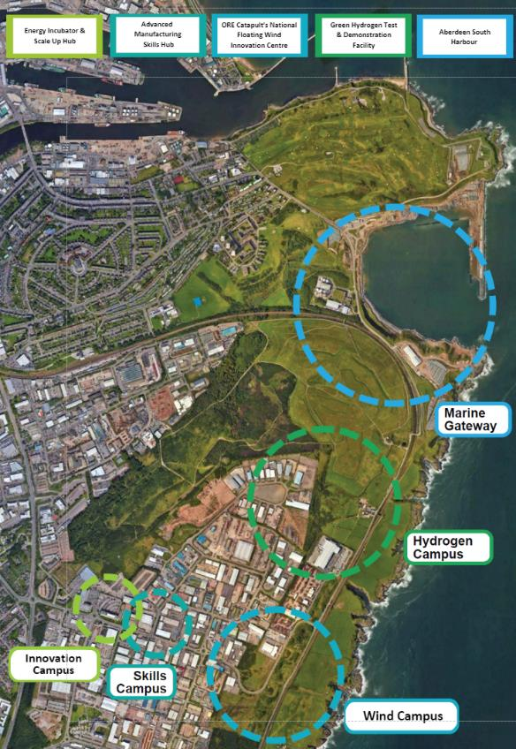
Land & Infrastruktur
Was ist die Energiewende-Zone?
Das ETZ befindet sich in unmittelbarer Nähe des neuen, 400 Millionen Pfund teuren Aberdeen South Harbour und ist eine Mischung aus Greenfield-Standorten und den Industriebrachen von East Tullos und Altens.
Wir haben uns verpflichtet, bis zu 40 Hektar Onshore-Anlagen zu entwickeln, die mit der Nordseeküste und dem Hafen verbunden sind und als kommerzielles Tor zur Offshore-Infrastruktur für erneuerbare Aktivitäten, einschließlich hochwertiger Produktion, fungieren.
Ein beispielhaftes Projekt, das sich auf Netto-Null konzentriert und Spitzeninnovationen beheimatet, was es zu einem Kompetenzzentrum für schwimmende Offshore-Windkraftanlagen und andere erneuerbare Energien, einschließlich grünem Wasserstoff, macht.
Ansässig in und neben einem Gebiet mit einem hohem Maß an Benachteiligung bietet ETZ die Möglichkeit, durch die Zusammenarbeit mit der Gemeinschaft die Entwicklung und die Chancengleichheit zu fördern, Vorteile für die Gemeinschaft zu erzielen und integratives Wachstum zu unterstützen.
Notes:
I mentioned earlier that we as well as all the skills and supply chain support work, we also have a physical redevelopment area to act as a focal point for the work we do.
The ETZ is in the immediate vicinity of the new £420m Aberdeen South Harbour and is a mix of greenfield sites and the brownfield industrial areas of East Tullos and Altens
We are committed to developing up to 40 hectares of on-shore facilities, connected to the North Sea coastline and harbour, acting as the commercial gateway to offshore infrastructure for renewable activity including high value manufacturing
An exemplar development focused on net zero and home to leading-edge innovation, making it a centre of excellence for floating offshore wind and other renewables, including green hydrogen
Located within and next to an area that has high levels of deprivation; by working with the community through its development, ETZ provides an opportunity to advance equality of opportunities, deliver community benefits and support inclusive growth

Slide 11
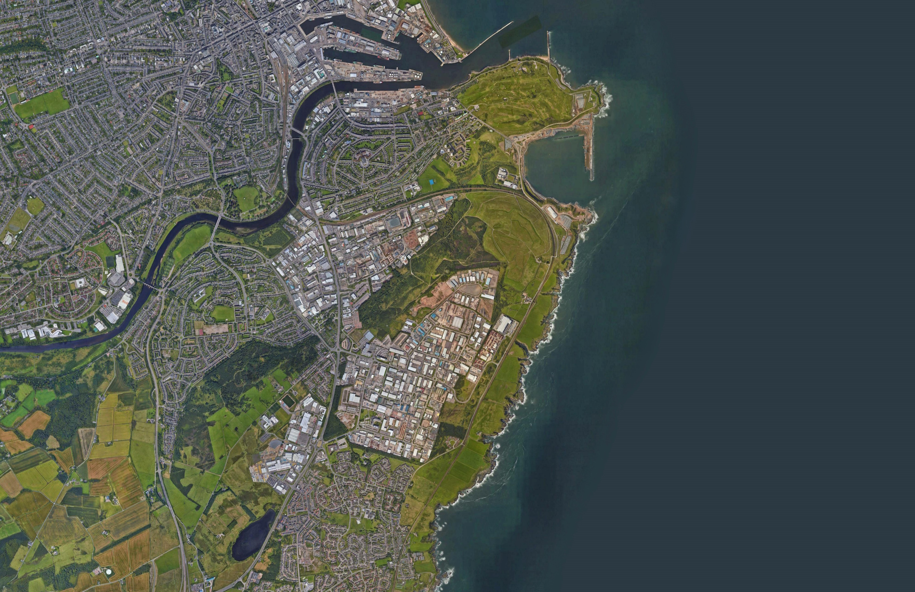


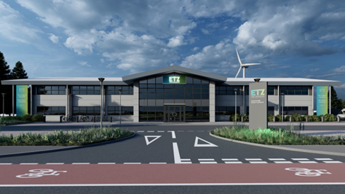
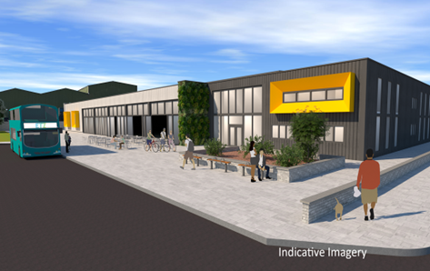
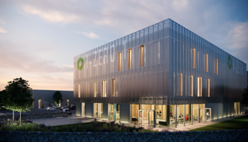
ENERGIEWENDEZONE
Aberdeen
Südhafen
Torry
Maritime Tor
Ein spezialisiertes Aktivitätscluster konzentriert auf den 400 Millionen Pfund teuren Aberdeen Südhafen und zielt in erster Linie auf hochwertige Produktionsmöglichkeiten ab.
East Tullos
Industriegebiet
Tullos Wood
Energiewende Campusse
Wasserstoff Campus
Ein Wasserstoff-Campus zur Bereitstellung einer Infrastruktur, die Test- und Demonstrationsanlagen für grünen Wasserstoff, Produktionsprojekte und hochwertige Fertigungsmöglichkeiten bietet.
Ein Offshore-Wind-Campus, der sich um das National Floating Wind Innovation Centre und Brachflächen östlich von Altens dreht.
Ein Qualifikationscampus, der sich um NESCol dreht und die Akademie zur Qualifikationen der Energiewende umfasst, ein Net-Zero-Exemplar, das zukünftigen Auszubildenden Wege zur Energiewende bietet.
Ein Innovationscampus, der sich um den neu gebauten Energy Incubator & Scale-up Hub dreht, der grüne Start-ups unterstützt.
Wir werden als Branchenkooperation entwickelt. Operativ im 4Q 2025.
In Partnerschaft mit ORE-Catapult. Betriebsbereit ab Juni 2023.
In Zusammenarbeit mit NESCol. Operativ im 3Q 2025.
In Partnerschaft mit bp & Scottish Enterprise. Operativ im 2Q 2025.
Innovation Campus
Skills Campus
Offshore
Wind Campus
Altens
Industriegebiet
Cove
Notes:
I mentioned earlier that we as well as all the skills and supply chain support work, we also have a physical redevelopment area to act as a focal point for the energy cluster in the form of The Energy Transition Zone (ETZ) – a physical area comprising a significant majority of revitalised brownfield accommodation alongside a new release of development sites, providing businesses with the unique opportunity to invest in the largest dedicated energy transition complex in Scotland.
Located within and next to an area that has high levels of deprivation; by working with the community through its development, ETZ provides an opportunity to advance equality of opportunities, deliver community benefits and support inclusive growth.
The zone will deliver 40 hectares of greenfield and brownfield sites for new business investment opportunities in energy transition-related projects and will develop activities that will support the transformation of the supply chain.
The Zone has been master planned using a campus model to encourage clusters of specialised activity and like minded companies to come together.
At the top of the map here you will see a “Marine Gateway” which is located alongside the new £420 million Aberdeen South Harbour development.
This area will support high-value manufacturing and assembly for renewables projects which will emerge from the ScotWind leasing rounds, including future offshore green hydrogen production.
There is also an Offshore Wind Campus, centred around the National Floating Wind Innovation Centre, will provide “flexible industrial units, suitable for a mix of manufacturing and supply-chain activities”.
A Skills Campus which is centred around the College and will include an Energy Transition Skills Academy due to be operational by quarter 3 2025.
An Innovation Campus centred around the Energy Incubator and Scale up Hub will support green start-ups, offering flexible accommodation with a space to learn and last week received planning permission.
And a Hydrogen Campus, which will provide infrastructure to support hydrogen production projects and high value manufacturing opportunities in the sector and you can see that highlighted on the map in yellow.

Slide 12
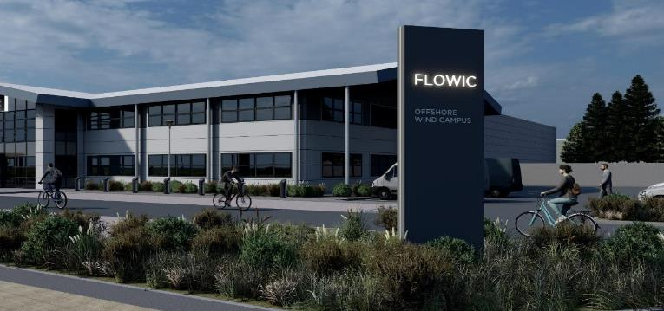
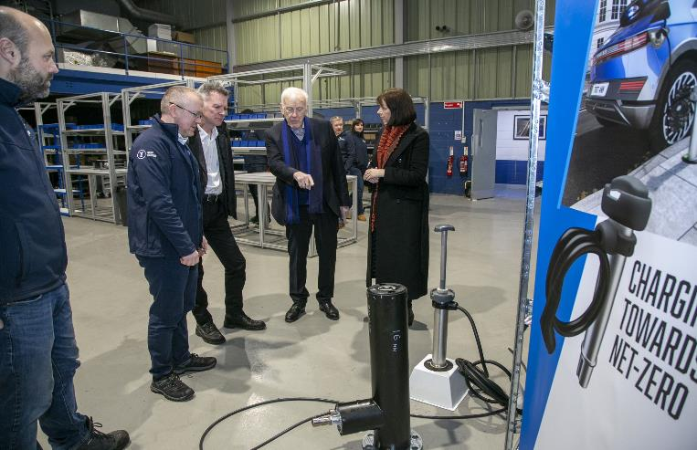
ETZ in Aktion: W-Zero-1
Frühe Entwicklung und Investition in Altens
Umfassende Sanierung eines W-Zero-1-Gebäudes – energieeffizient und umfunktioniert
Hier befindet sich das National Floating Wind Innovation Centre (FLOWIC) von ORE Catapult, das im Sommer 2023 eröffnet wurde
Hauptsitz und Produktionsstätte von Trojan Energy zur Herstellung von Ladesystemen für Elektrofahrzeuge.
Flexibler Raum für innovative Unternehmen, die an der Energiewende beteiligt sind
Notes:
The Wind Campus is our most developed project and our first building officially opened this year.
Comprehensive refurbishment of W-Zero-1 building – energy efficient and re-purposed
Home to ORE Catapult’s National Floating Wind Innovation Centre (FLOWIC) opening summer 2023
HQ and production facility for Trojan Energy to manufacture electric vehicle charging systems.
Flexible space for innovative companies involved in the energy transition

Slide 13
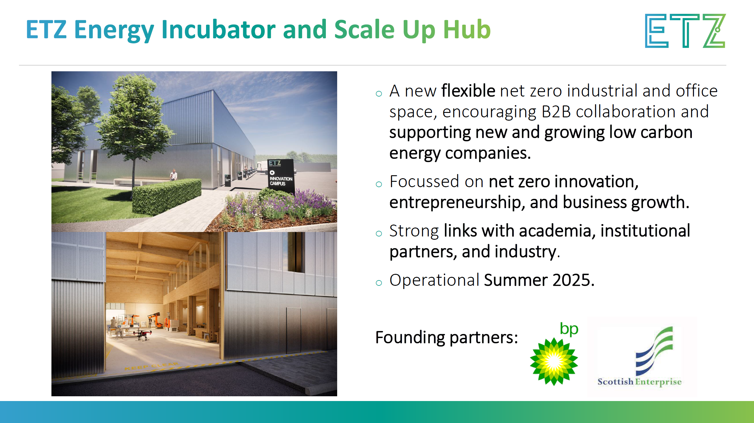
Notes:
The Energy Incubator and scale up hub will be the entry point for new and growing supply chain organisations to receive support and flexible accommodation and build links with academia, institutional partners, and industry.
It will create a purpose-designed and managed environment for net zero innovation, entrepreneurship, and growth; where partnerships are formed, and ideas are developed and brought to market.
Partnering with NMIS, bp and Scottish Enterprise
The facility will offer manufacturing space, collaboration space and office accommodation.
Building has started onsite and it will be ready mid 2025.

Slide 14
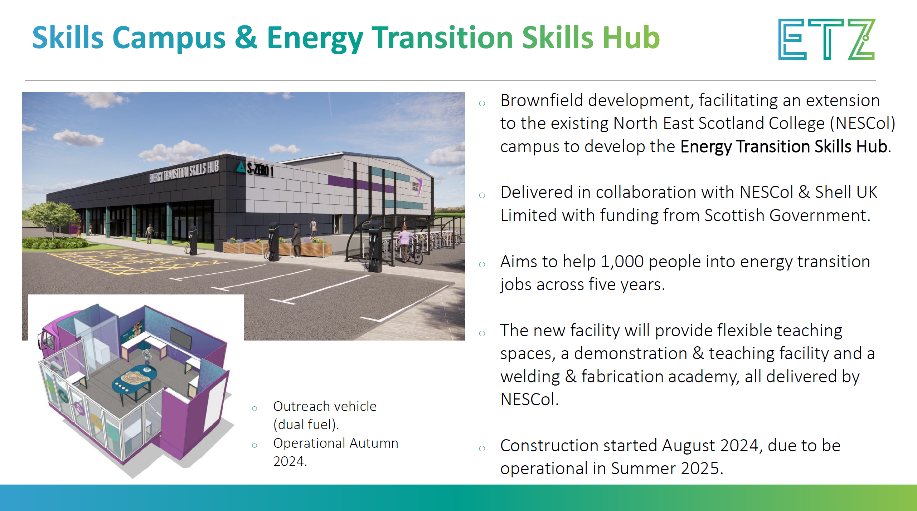
Notes:
ETZ

Slide 15
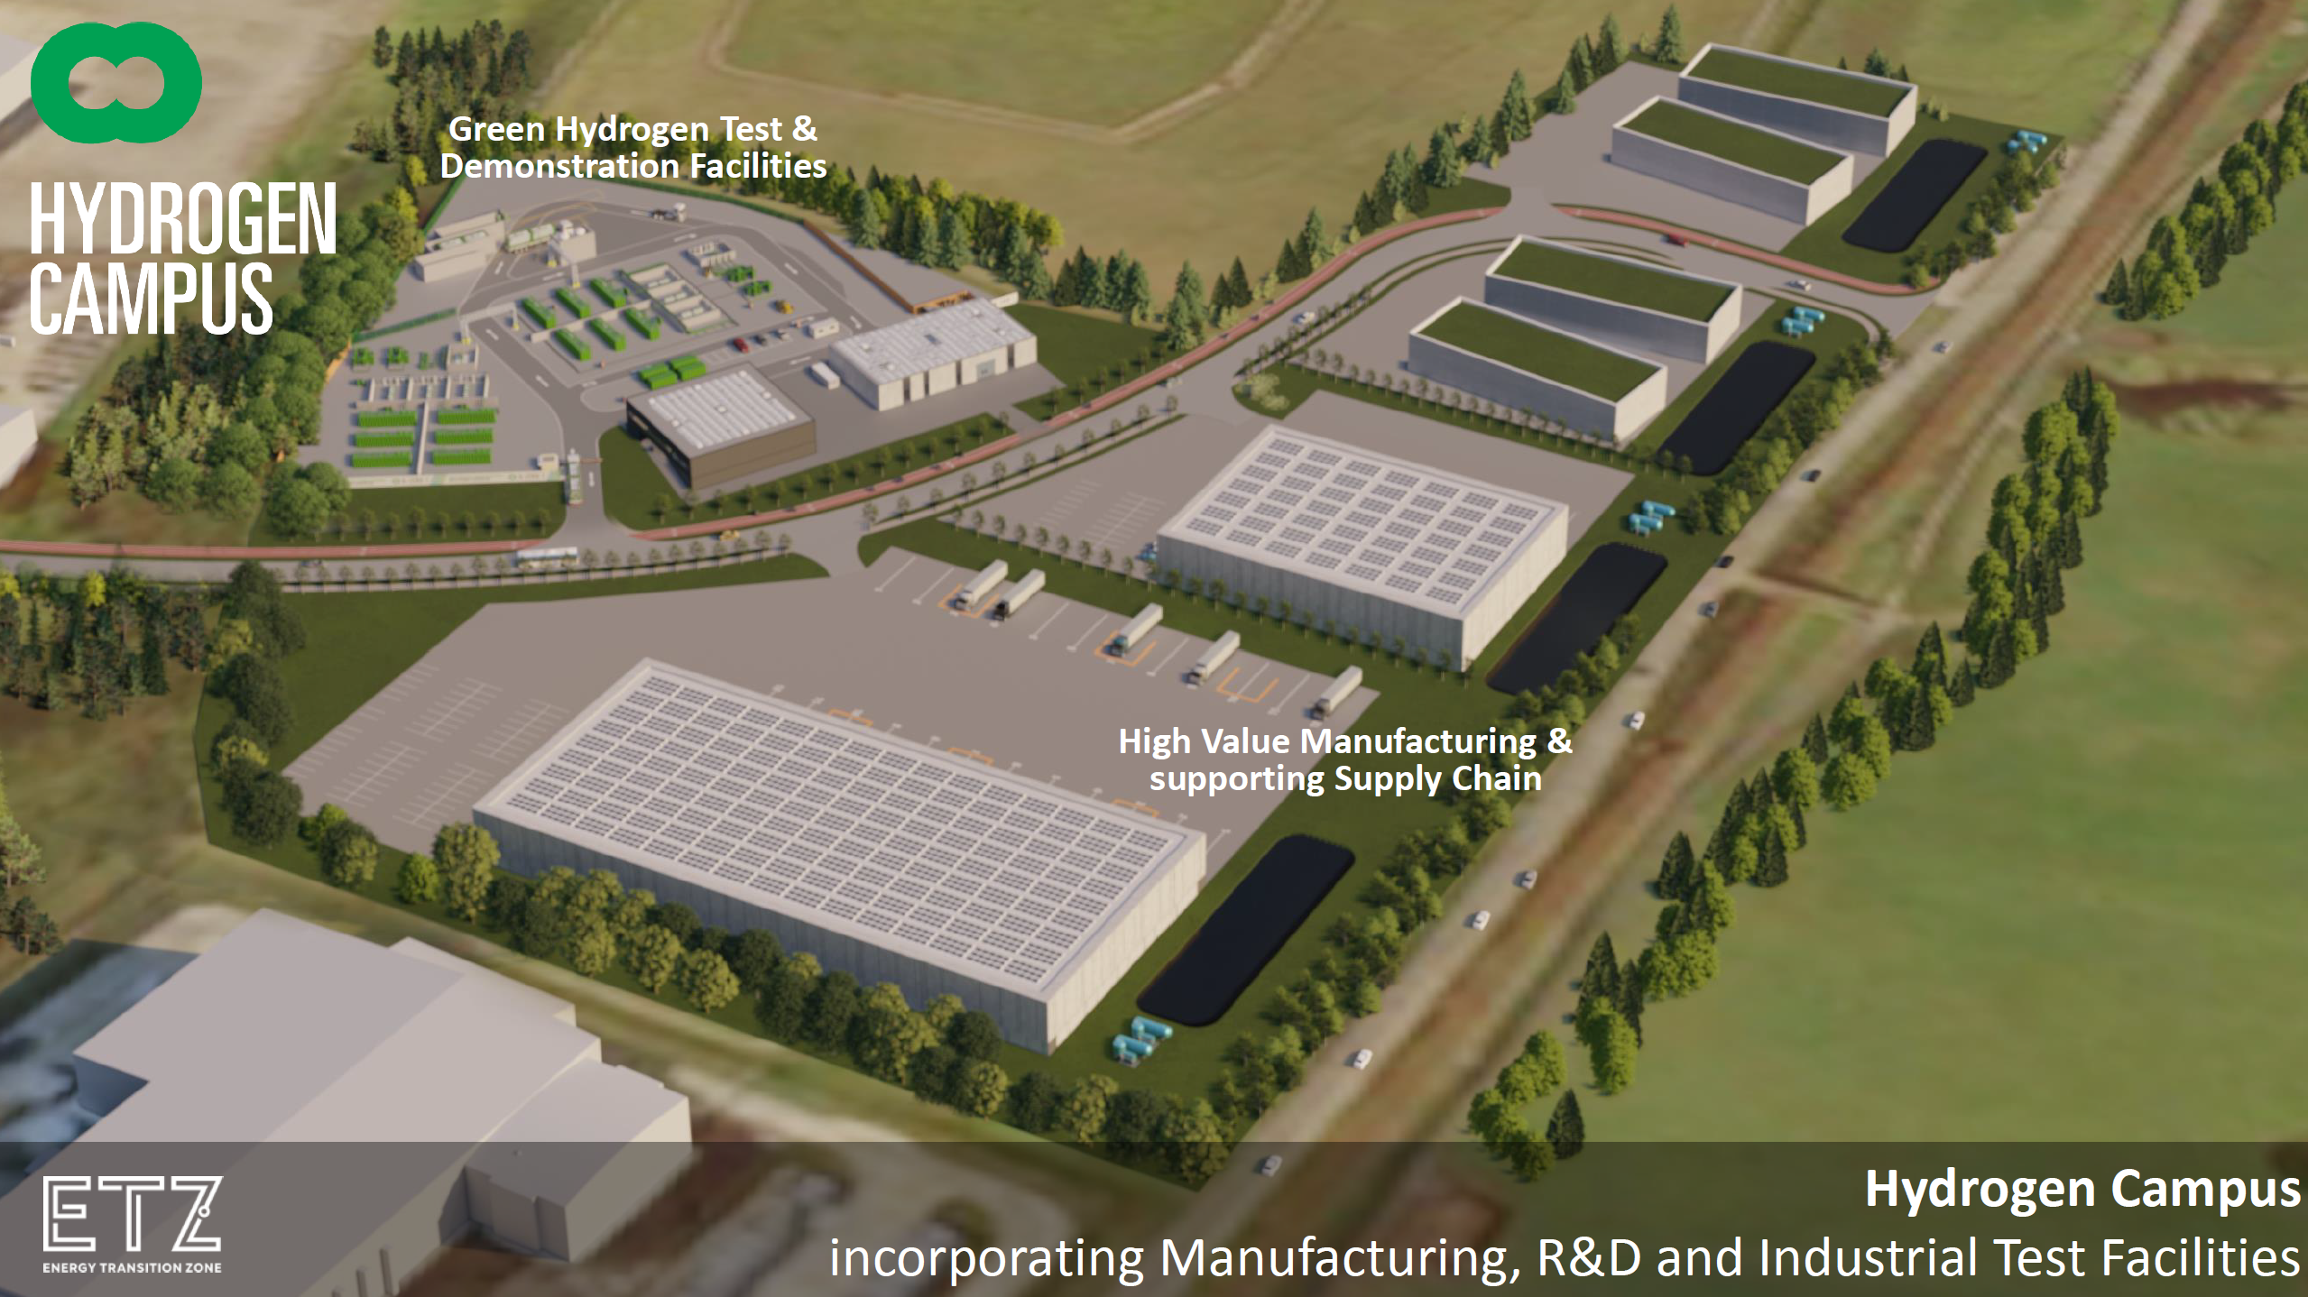
Proposed ETZ Hydrogen Campus
Indicative Concept Subject to Planning Consent
Notes:
The creation of a Hydrogen Campus in the ETZ is proposed to further strengthen Aberdeen as a “centre of excellence for hydrogen”, with the aim of encouraging a cluster of companies specialising in hydrogen technologies to develop in the area.
The campus area is made up of both brownfield and greenfield development with a total net developable area of approximately 15 hectares, which could accommodate up to 31,000m2 of building space.
This image gives an idea of the capacity of the site and what it could look like once developed. A key target for ETZ & Scotland is to encourage an electrolyser manufacturer to the region.
The key anchor project that ETZ will develop within the campus is the Green Hydrogen Test & Demonstration Facilities.

Slide 16
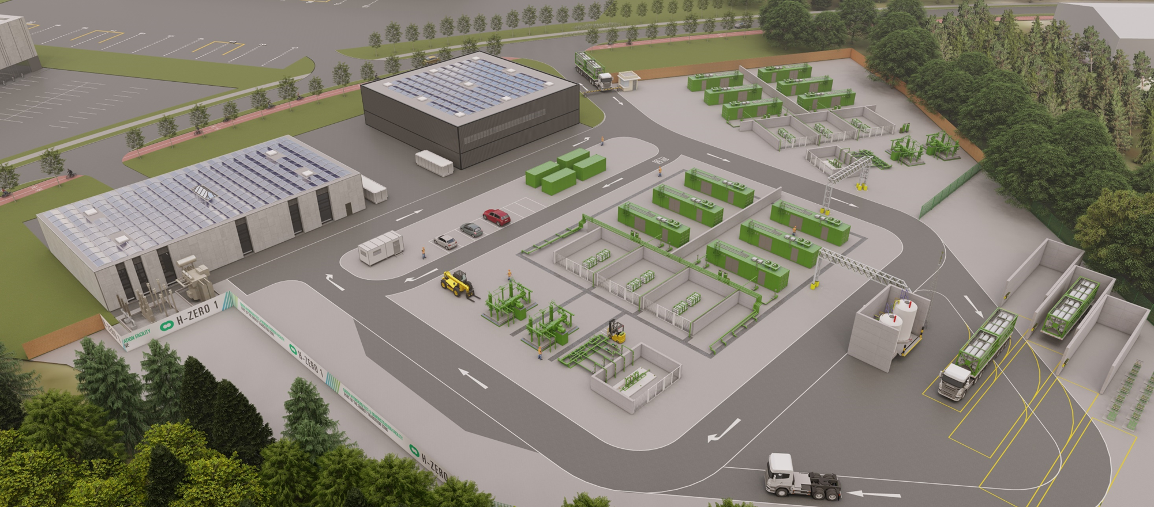
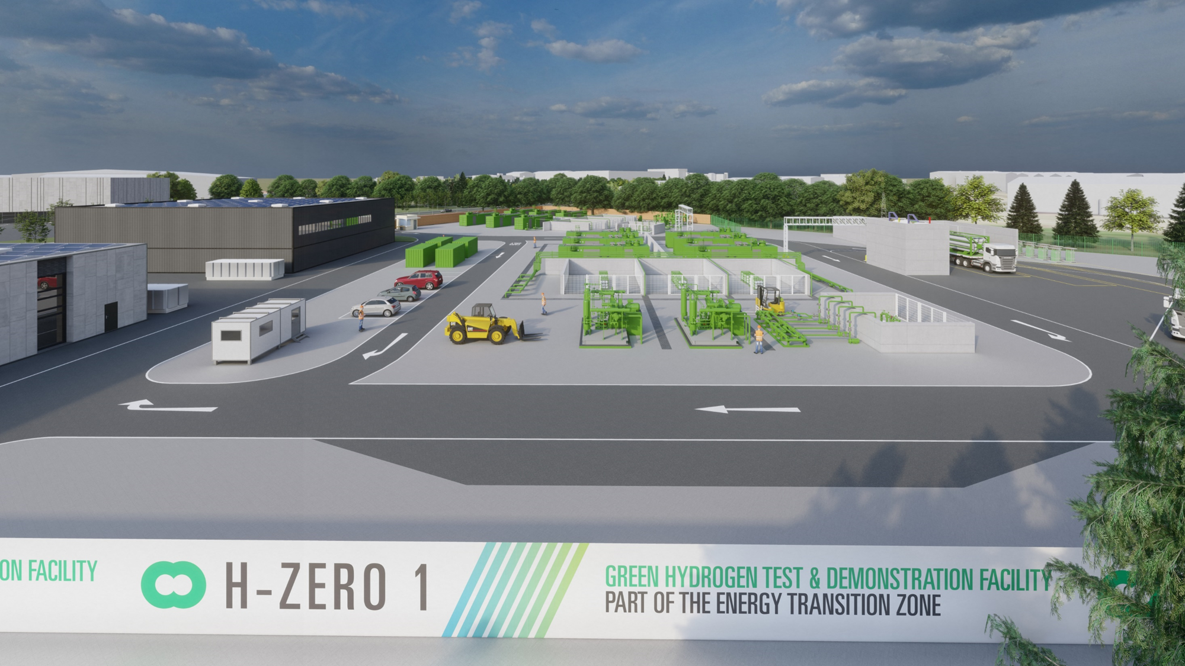
Test- und Demonstrationsanlagen für grünen Wasserstoff
Modernste Prüfeinrichtungen
Speziell entwickelt für Wasserstofftests
"on demand"-Quelle für lokal produzierten grünen Wasserstoff
Prüfbereiche im Freien, die für containerisiertes Zubehör geeignet sind
Flexibilität im Design ist der Schlüssel - organisches Wachstum wird von den Bedürfnissen der Industrie bestimmt
Notes:
These state-of-the-art testing facilities will provide industry with purpose-built facilities fed by a local supply of green hydrogen, aiming to be operational by end 2025.
The facilities will be built in phases, focusing on outdoor testing to begin with, whilst maintaining flexibility to allow organic growth of the facility overtime which reacts to market needs.
ETZ will work with partners to provide wrap around support to organisations using the facility – for example operational & legislative advice, safety and business support where required.

Slide 17
Amy Perry
Project Development Manager (Hydrogen)
E: Amy.Perry@etzltd.com
M: 07778280293
Notes:
So that is a snapshot of the things that ETZ ltd are undertaking in Scotland to stimulate jobs and move the supply chain to net zero.

